Slide 1
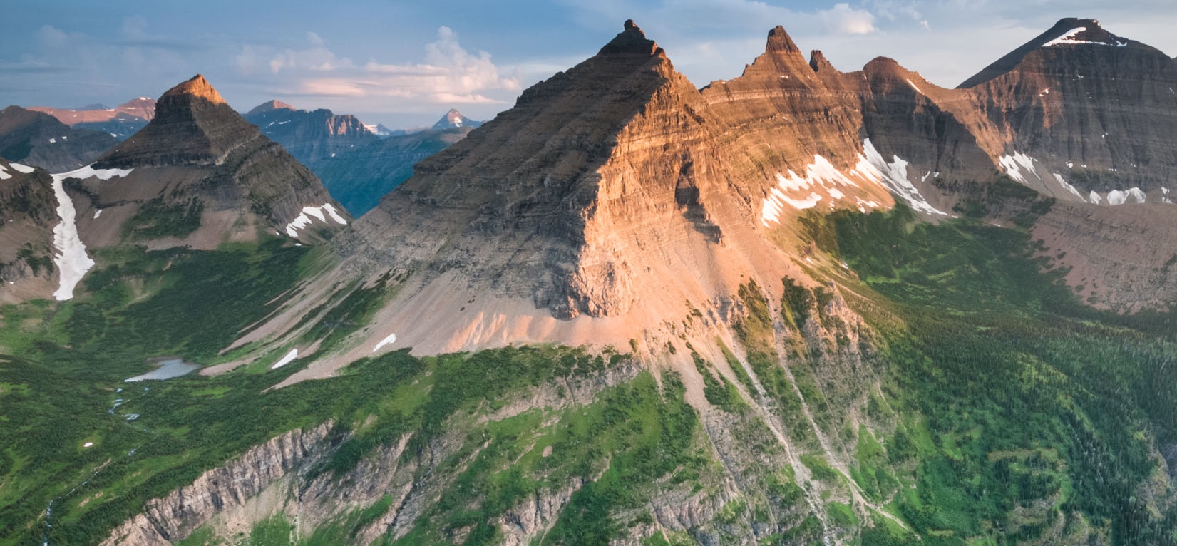
Updates on quantitative hydrologic storylines at NCAR
Characterizing uncertainty and advances in large ensemble computational hydrology
Joseph Hamman, PE, PhD
NCAR Research Applications Laboratory
Photo: Steven Gnam
US Army Corps of Engineers Seattle District
Friady March 30, 2018
Notes:
Time to think about why we do the things we do, and HOW we do it. Which, if the goal is doing useful science arguably more important.
How is the information created here translated into something that serves society.

Slide 2
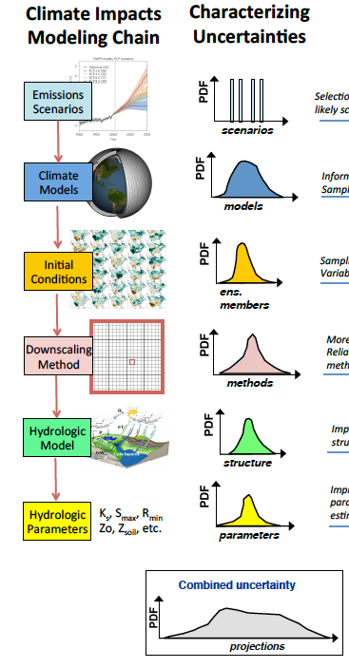
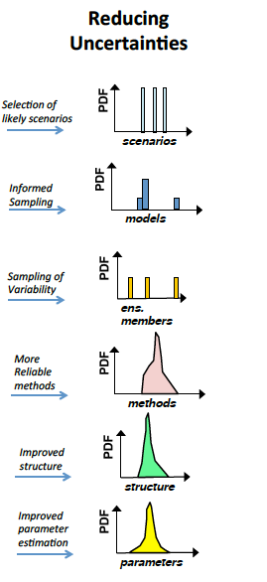
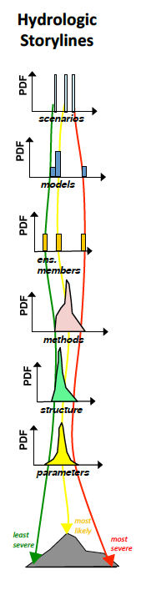
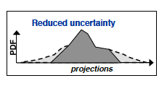

Quantitative Hydrologic Storylines
Explicitly estimate dominant sources of uncertainty in order to characterize the range of outcomes
Reduce uncertainties
Sample from the range to construct quantitative hydrologic storylines useful for water resources planning
Notes:
EMBRACING UNCERTAINTY
Consider model diversity, model fidelity, and model sensitivity.
Are there ways to understand climate change impacts that are less computationally involved and focus on the impact you care most about?

Slide 3
Revealing and reducing uncertainties
Example from the Hydrologic Response of the Columbia River System to Climate Change [Data set]
2 RCPs
10 GCMs
2 Downscaling Methods
1 (2) Hydrologic Model*
2 (4) Parameter Sets**

Slide 4
Changes in Streamflow Metrics (2080s-1980s)
Analysis of Variance (ANOVA)
Model Parameters
What about the downscaling methods?
e.g. How different are BCSD and MACA?
Notes:
Interaction terms are lumped in with the residuals

Slide 5
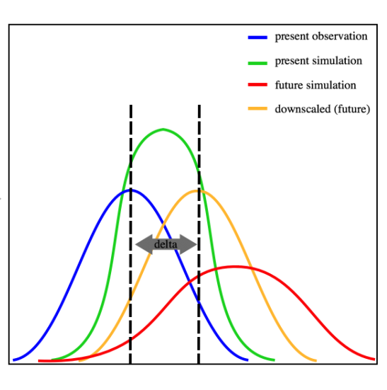
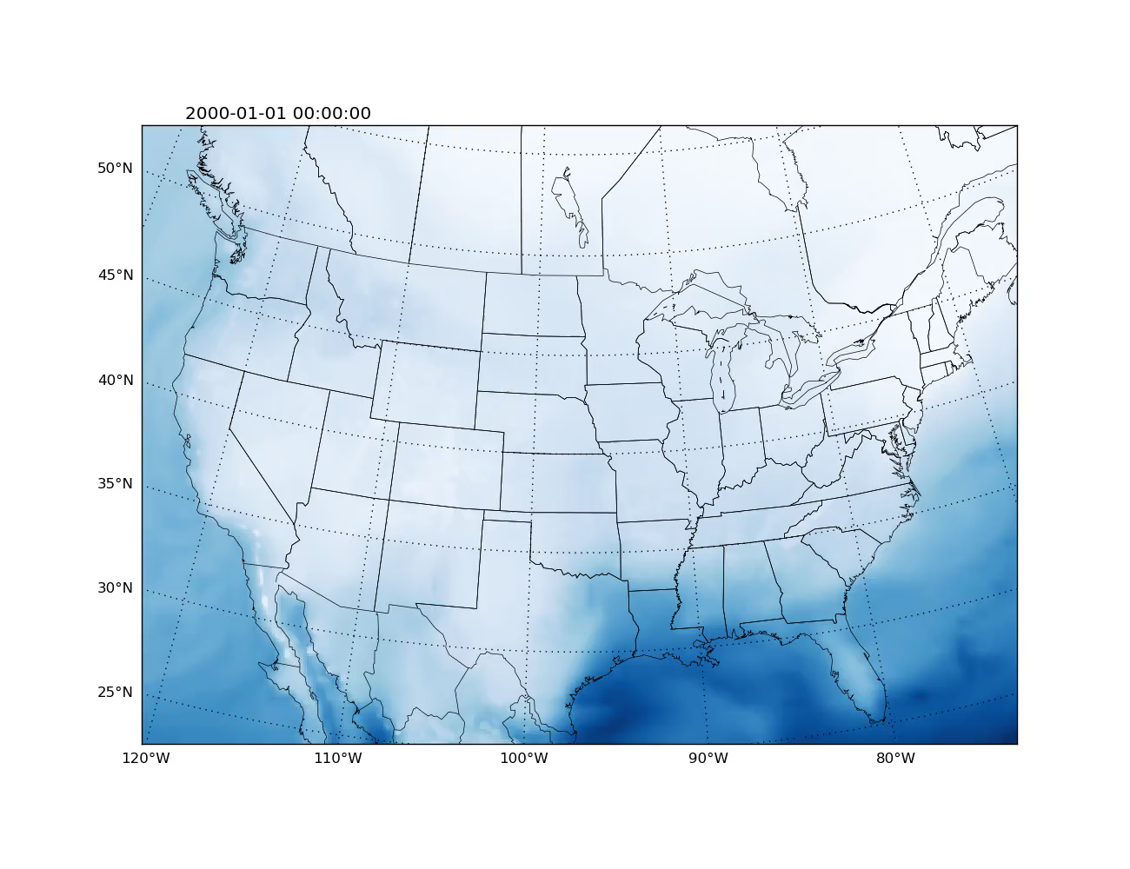
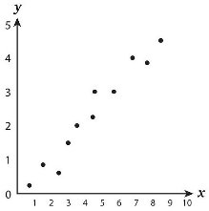
Downscaling Method Complexity
ICAR
Increasing methodological complexity in downscaling methods
GCM
Raw
(spatial
interpolation)
Delta
Method
BCSD
Linear
Regression
Analog
Analog
Regression
Machine
Learning
Low-res RCM
+ regression
(+ combinations)
ICAR
High-res
RCM
(Multivariate)
Observations
GCM
Tradeoffs:
Physical realism vs. computational cost
Single realization vs. ensemble
Explicit physics/feedbacks vs. simplicity
En-GARD is targeting this space
Notes:
1) Ethan introduced the notion of a “Conceptual Divide in Downscaling” between statistical methods and full physics regional climate models.
2) We’re trying to make the argument that there are actually a spectrum of methods that incrementally add complexity.
3) We’ve been working on developing tools that are efficient enough to be used on large numbers of climate simulations but that include more physical realism
4) Today I’m talking about a new downscaling tool, En-GARD, that targets a complexity space between single variate SD methods and reduced physics GCMs.

Slide 6
Developing a large ensemble of downscaled data
Large ensemble of downscaled meteorological projections over 1/8° CONUS domain
Combines existing and new methods
Key point: Using this dataset, we can explore questions of how and why different change metrics vary between GCMs and downscaling methods.
10 GCMs X 2 RCPs X ~16 DS Methods
Variables (daily)
Precipitation
Mean Temperature
Diurnal Temperature Range
CMIP5 - RCP8.5
Notes:
We’ve been developing a large ensemble (~350 members) of downscaled meteorology for use in hydrologic modeling
Combining a range of downscaling products (BCSD, LOCA, ICAR, and a bunch of GARD ensemble members).
The GARD and ICAR members in the results here are driven by the same 50-km WRF dataset
Existing datasets like BCSD and LOCA are taken off the shelf from their respective locations

Slide 7
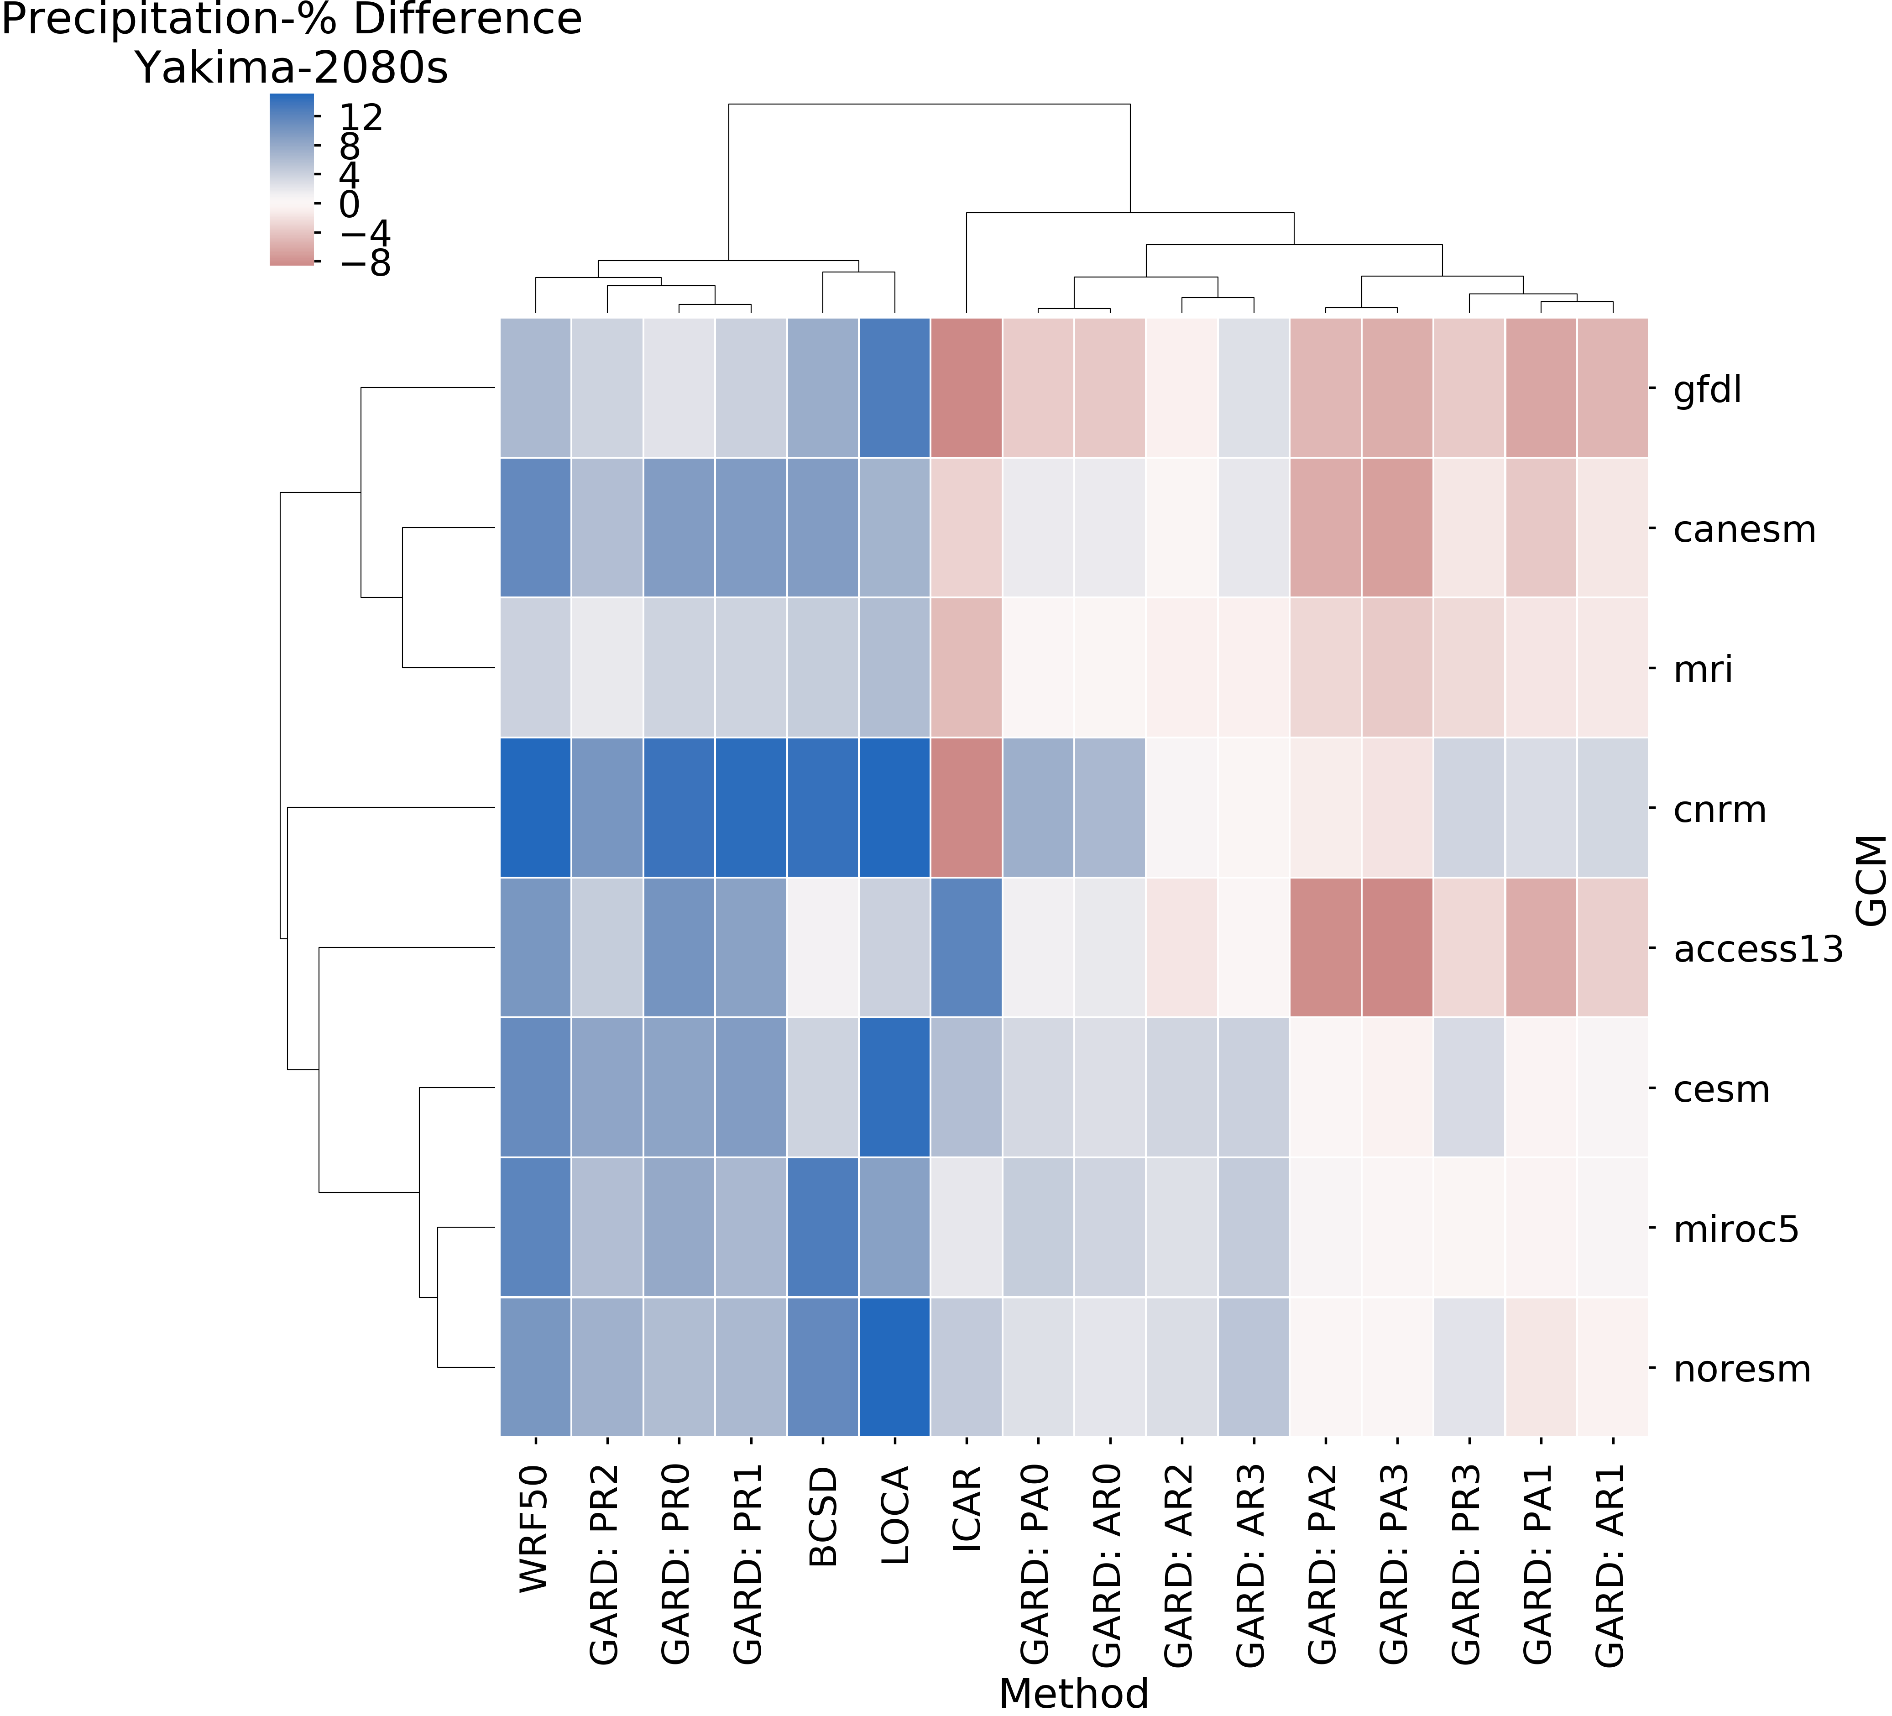
Examining ensemble structure
Change in Precipitation
Yakima River Basin (RCP 8.5 2080s-1980s)
Obvious Point: Downscaled change signals can vary substantially by both downscaling methods and GCMs.
Key questions:
Why do predicted changes have opposite signs between different downscaling methods?
How closely should we expect downscaled change signals to agree with the change signal from the driving GCMs?
What do we loose when we inforce the GCM signal on the downscaled dataset?
Metric: Change in mean annual precipitation (%)
Notes:
I wanted to show a few examples of what we can start to do with this dataset. Disclaimer: we’re just starting to work with the dataset so todays results are just a preview. (Come back next year if you want all the answers)
This is a clustermap. Basically a heat map, showing change in precipitation for the Yakima River Basin in the PNW. The columns and rows have been arranged such that the methods and GCMs are clustered next to others that have like changes.
Take away points. There are some big differences here. +/- 10% of current precipitation. You can find that range along either the GCM or DS axis.
If we isolate along a few GCMs or a few DS methods, we can really see how diverse these change signals can be.
This leaves us with a few questions:…

Slide 8
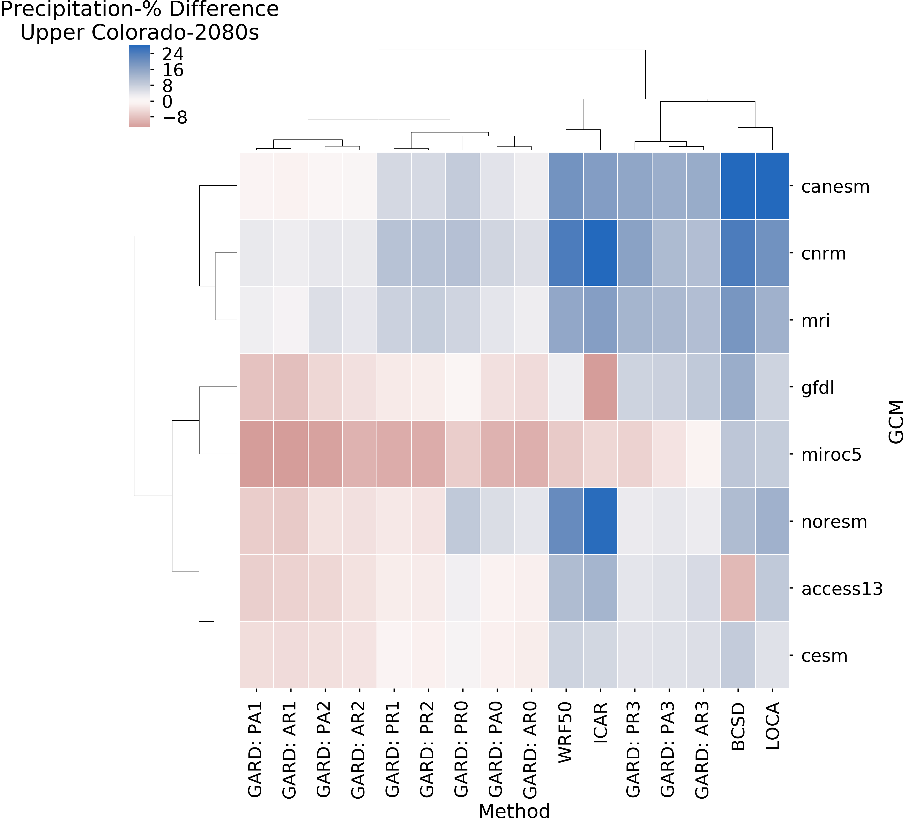
Sensitivity changes by metric and location
Change in Precipitation
Yakima River Basin (2080s-1980s)
Change in Precipitation
Upper Colorado River Basin (2080s-1980s)
Metric: Change in mean annual precipitation (%)
Notes:
1) Obviously, I’ve just shown you one basin. We’re looking at many more. Here’s an example from the Colorado as well.
2) Upon inspection, we can see that the relative position and signs have changed for all of these methods.
3) A take away point here is that if we had just looked at BCSD and LOCA, we may have concluded that downscaling methods are not all that important (not all that uncertain)

Slide 9
Understanding hydrologic change and model structure
Ensemble mean (10 GCMs, RCP 8.5) changes (2080s-1990s) in key hydrologic variables
Three different hydrologic models, all run with BCSD forcings
Relative change (%)
Figure adapted from Nans Addor’s 2017 EGU presentation
Notes:
Figure 2: Simulations for the reference period (1980-2009, top three rows) and relative change projected under future
conditions (2070-2099, RCP8.5, bottom three rows). The mean of the 10 simulations (one per GCM) per hydrological model is shown.

Slide 10
Understanding hydrologic change and model structure
Current work is focused on developing a large ensemble of hydrologic model simulations
This ensemble will be used to explore:
Role of hydrologic model structure/parameters
Sampling / culling approaches
Syntheses of uncertainty as a function of metric and methodological choices
Current Ensemble Scope
2 RCPs
~30 GCMs
1-30 Members*
10-15 Methods
4+ Models
1-10 Sets

Slide 11
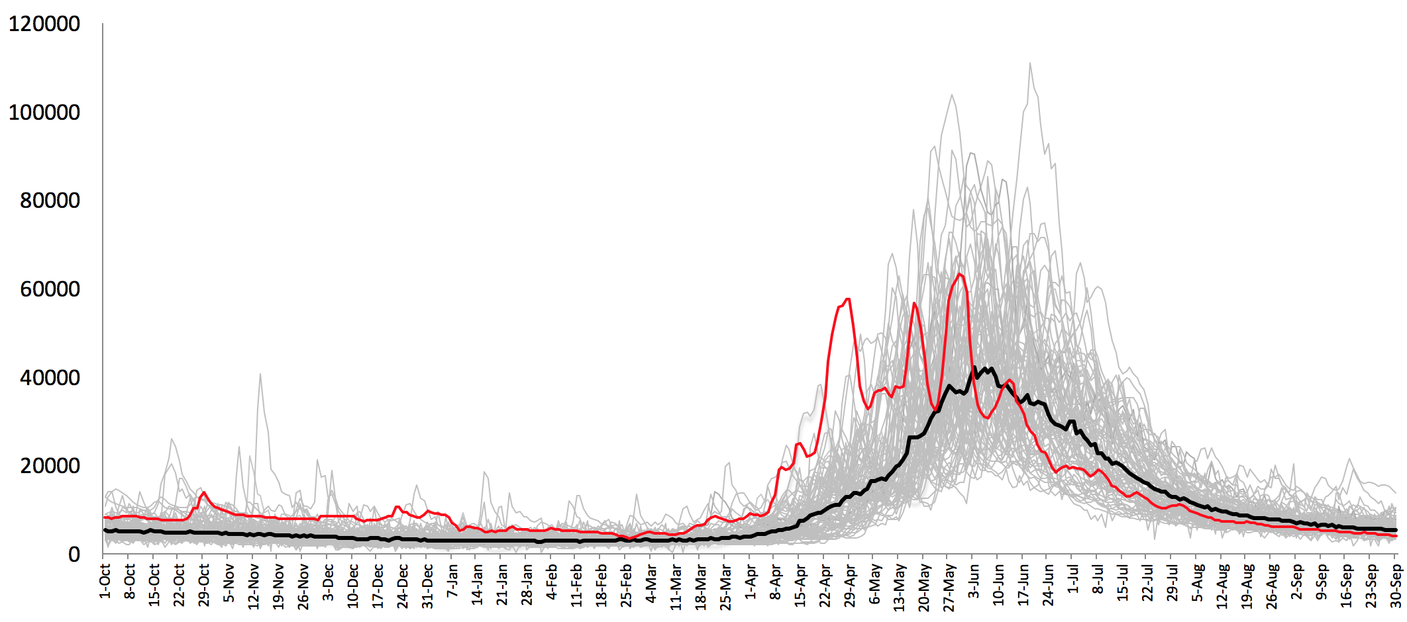
Variables worth collecting
Daily streamflow at specific locations
Metrics
wet and dry years
high flows and summer low flows
volume shifts/seasonal hydrograph
Apr-Aug volume
½ annual flow volume
winter/spring volume ratio
consecutive dry years
used as input to other models
others?
Questions
What locations are important? (e.g., reservoir inflows, inputs for regulation models)
Re: ½ annual volume – what is the starting point? water year? beginning of refill?
Daily gridded runoff + baseflow
Metrics
routed flow to any location (above)
drought measures (e.g., standardized runoff index)
Questions
what drought indices are important? (e.g., 20th percentile of Apr-Aug volume)
dry years less than 4.8 MAF
wet years greater than 7.5 MAF
individual years
median
1934
Libby Reservoir (1928-2008) data from BPA, NRNI

Slide 12
Variables worth collecting
Daily temperature
Metrics
seasonal changes
used as input to other models (stream temperature, fire models)
Daily rain AND snow
Metrics
changes in fraction precip that comes as rain v. snow (e.g., 2011 big year, but mostly snow v. 2012, Apr-Aug got 2 MAF rain and was more problematic)
amount of rain (and snow) that comes in June
elevation of snowline (4000-4500, 5000,6000, 7000m)
Standardized precip index (SPI) drought indicator
Questions
Re: snowline – is it the event itself or where snowline is that year?
Daily snowmelt, area upstream of gage
Metrics
date of peak (when 50% annual volume)
Questions
Does this give additional insight v. just ½ annual flow volume?
Drought measures that include ET or soil moisture
Questions
What drought measures are important?

Slide 13
Metrics, reduced to a single number
Streamflow
1. Water supply season: flow volumes April-Aug (Libby), April-July (Dworshak)
2. Dry years
# of yrs April-Aug below 4.8 MAF for Libby.
OR: avg of 10 driest April-Aug years in 50-year period (or 20% of whatever number of years)
3. Wet years
# of yrs April-Aug above 7.5 MAF and 9 MAF for Libby
OR: avg 10 wettest April-Aug years in 50-year period
4. Flow magnitude
# of yrs with 7-day cumulative volume over X (e.g., 3000 cfs peak at Dworshak)
OR: highest 7-day cumulative volume for each year and take the top 10 years
OR: highest 7-day cumulative volume (highest single event)
OR: average annual 7-day cumulative volume
5. Seasonality
# of yrs Jan-Mar is greater than 1.0 MAF for Libby
OR: flow volumes Jan-Mar
AND/OR: average of 10 wettest Jan-Mar
Other possibilities:
- Normal years: instead of wettest or driest, what about average of 20-80% (might be interesting to compare wet, normal, dry)
- System-wide triggers: most are percentages (e.g., # of dry yrs at The Dalles, # of back-to-back dry yrs)
Precipitation/snow:
1. change in fraction of how much Apr-Aug precip is rain (vs. snow)
2. amount of rain in June
3. something that captures the changes in snowlines

